Slide 1
Machine Learning: The Process and Nearest Neighbors
Link to this document
Applied Python

Slide 2
What are we doing?
Learning Objectives
By the end of this week, you should:
understand the k-nearest neighbor algorithm.
identify contexts in which machine learning is appropriate.
know the machine learning process.
Measurable Outcomes
By the end of this week, you should be able to:
describe the differences between supervised, unsupervised, and reinforcement learning.
load, split, train, and test and validate a dataset.
classify previously-unclassified data using machine learning.

Slide 3
MACHINE LEARNING

Slide 4
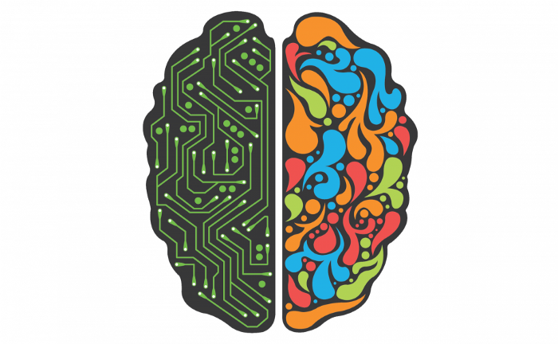
What is machine learning?
Machine learning (ML) is the study of algorithms that improve themselves by experience. It is a subset of artificial intelligence (AI) - the ability of a computer to perform tasks typically associated with living creatures.
source: https://blog.kensho.com/mastering-the-two-halves-of-your-brain-62d0c0d4f216

Slide 5
How does this related to LLMs?
Modern machine learning is most readily seen in the pervasive LLMs - Large Language Models - which are being bolted into everything from customer service chatbots to full-stack web development to defense technology.
Machine learning has been around for decades, however, and "classic" machine learning is still seen in many applications - including but not limited to image recognition and generalized business decisions.

Slide 6
ML: the algorithm and the model
A model is a hypothesis about the world. It is created from data by applying some machine learning algorithm. Ideally, as more data is fed into the algorithm, the model improves.

Slide 7
ML: mathematical generalization
Machine learning applies a prediction function to a feature of a dataset to get the desired label:
y = f(X)
label
prediction function
feature vector

Slide 8
Datasets
A dataset is nothing but a collection of data. Generally, it will have 2 main components:
Features (also known as predictors, inputs, or attributes): the variables of the data. They can be more than one and hence represented by a feature matrix (capital ‘X’ is common notation).
Target (also known as the prediction, response, or label): the output variable, which depends on the feature variables. There is generally a single response column and it is represented by a label vector (lowercase ‘y’ is common notation).

Slide 9
ML: features
A feature is an individual measurable property of the dataset. The practical manifestation of a feature is a column in a DataFrame.
A set of features can be described by a feature vector. Feature vectors are fed as input to the model. For example, in order to predict a fruit, there may be features like color, smell, taste, etc.

Slide 10
ML: target
The target is the thing the model is trying to predict. It is also represented by a column from a DataFrame. In that target are categorical values - which in ML are called labels. The label is the value to be predicted by your model. For the previous fruit example, the label with each set of input would be the name of the fruit (apple, orange, banana, etc.).
When a model is being trained, the data it learns on is split into classifications: target labels. Then the data is run through the model, which classifies each datapoint with a label - in other words, a prediction.

Slide 11
ML: training and testing
In order for an algorithm to "learn", it must be trained. Training involves giving the algorithm a set of inputs (features) and its expected outputs (labels).
Then after training, you will have a model (hypothesis) that will then map new unclassified/uncategorized data to one of the categories/target labels/prediction trained on - in other words, at this point, you'll be testing the model.

Slide 12
ML: paradigms
There are effectively three core machine learning paradigms:
Supervised learning
Unsupervised learning
Reinforcement learning

Slide 13
ML: supervised learning
Supervised learning involves presenting the algorithm with example inputs (features) and their desired/expected outputs (labels), given by a “teacher”, and the goal is to learn a general rule(s) that maps inputs to outputs. The training process continues until the model achieves the desired level of accuracy on the training data.
So for example, in computer vision, you would train your algorithm with images with known features and labels.
Then in the future you give a new uncategorized image expecting that the computer will recognize the new object.

Slide 14
ML: unsupervised learning
In unsupervised learning, no labels are given to the learning algorithm, leaving it on its own to find structure in its input. It is used for clustering population in different groups. Unsupervised learning can be useful for discovering hidden patterns in data.
For example, cluster analysis is an ML field that makes extensive use of unsupervised learning. Unsupervised learning will ideally extract previously-unnoticed classifications based on these clusters.

Slide 15
Reinforcement learning
Reinforcement learning involves itself with how software agents should take actions in their environment. Usually, this is done by tying the output to a reward function, and the algorithm attempts to maximize this function.
Self-driving cars are a great example of reinforcement learning: based on the data coming into their sensors, they try to maximize the reward function. Their reward function is tied directly to, among other things, not running into anything.

Slide 16
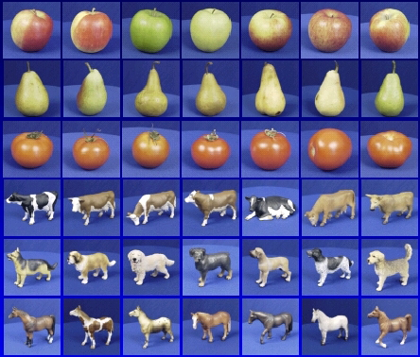

ML: the process overview
y_train (supervised)
Training
Training Labels
Training Images
X_train
X_test
X_train
Features
Training
algorithm
Trained model
X
fit()
y_test
Test Truth Labels
train_test_split()
Testing
X_test
predict()
Features
Trained model
Prediction
Score
y_pred
source: http://www.cs.cornell.edu/courses/cs5670/2019sp/lectures/lec20_image_classification.pdf

Slide 17
Spreadsheet Example
 |  | X |  | y target label |  | prediction
features | color | texture | bitterness | fruit Name
 | light red | soft | not very | apple
 | 0x558684 | 2 | 3 | apple
 | 0x448685 | 7 | 5 | peach
X_train | 0x558686 | 2 | 4 | pear | y_train
 | 0x558687 | 3 | 3 | apple
 | 0x558688 | 2 | 2 | apple
X_test | 0x558689 | 1 | 5 | peach | y_test | peach | y_pred
 | 0x558690 | 2 | 3 | pear |  | apple
Notes:
Categorical Data in pandas
https://pandas.pydata.org/docs/user_guide/categorical.html
Convert all strings to numbers to make sci kit learns job easy/possible

Slide 18
ML: the process
The process of supervised ML is pretty simple. There are only a few steps:
Wrangle (including a couple you haven't seen yet):
formatting, NaN and nulls, dupes, etc.
Separate into feature matrix and target vector
Split into training and testing
(If necessary) transform the feature matrix
Train the model
Application of the model - i.e. predict and validate

Slide 19
ML: algorithmic approaches
Unsurprisingly, there are many algorithmic approaches to ML - including but not limited to:
Neural networks
Naïve Bayes
Logistic / Linear regression
Decision Trees
Support Vector Machines (SVM)
K-nearest neighbors (KNN)
Let's begin by exploring just one of these: K-nearest neighbors. Note that while you can use KNN as a supervised regressor, the examples in this class will only use it as a supervised classifier.

Slide 20
K-NEAREST NEIGHBORS

Slide 21
ML: KNN intuition
The intuition for the K-Nearest Neighbors algorithm is actually very straightforward: you are more likely to be similar to your neighbors than you are to those further away from you. The KNN algorithm simply mathematically formalizes this approach. Given a dataset and a new item, it will attempt to find the closest records in the dataset to that item, at which point it will return the majority classification of the closest records.

Slide 22
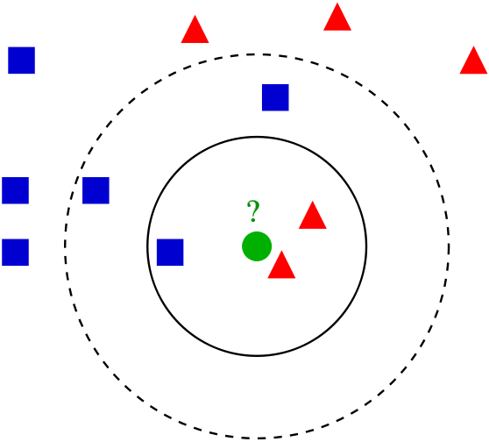
ML: KNN visualized
From Wikipedia:
Example of k-NN classification. The test sample (green dot) should be classified either to blue squares or to red triangles. If k = 3 (solid line circle) it is assigned to the red triangles because there are 2 triangles and only 1 square inside the inner circle. If k = 5 (dashed line circle) it is assigned to the blue squares (3 squares vs. 2 triangles inside the outer circle).
source: https://en.wikipedia.org/wiki/K-nearest_neighbors_algorithm
Notes:
Note, as you increase k, the number of neighbors to compare against, yes, you’re making more comparisons but you’re also comparing to things increasingly more different from the new item where different is defined as average difference of features as you increase k.

Slide 23
ML: KNN Training and Prediction
Training Algorithm
Initialization:
Choose a value for k.
Each datapoint in the training set is placed in n-dimensional space
(That's literally it. KNN is simple.)
Prediction from the Model
For each new record:
Calculate the sum of differences between the new record and all the training-set records.
Sort the sum of differences.
Select the first k records corresponding to those sum of differences.
Find the most common label in those records.
Return that label: the prediction.

Slide 24
SCIKIT-LEARN

Slide 25
scikit-learn: the basics
scikit-learn (also called sklearn) is an open source Python library that implements a range of machine learning, pre-processing, cross-validation, and visualization algorithms using a unified interface.
Important features of scikit-learn:
Simple and efficient tools for data mining and data analysis. including various classification, regression and clustering algorithms.
Open source, commercially usable – BSD license.
Built on the top of NumPy.

Slide 26
scikit-learn: installation
As usual, you'll need to install this package manually as it doesn't come prepackaged with Python.
You're going to be working with a particular dataset called iris (more on that later) as well as an algorithm called K-Neighbors Classifier, so you should import them as well.
import numpy as np
import pandas as pd
import matplotlib.pyplot as plt
from sklearn.model_selection import train_test_split
from sklearn.preprocessing import StandardScaler
from sklearn.neighbors import KNeighborsClassifier

Slide 27
ML Step 1a: Wrangle
The first thing you'll need to do is load in an existing dataset and get it into the form you'd like. You'll be using the iris dataset; it's effectively the ML equivalent of Hello World.
Note: dealing with missing or malformed data and outliers is skipped for brevity. (This data is actually really nicely formatted already anyway.)
import numpy as np
import pandas as pd
import matplotlib.pyplot as plt
from sklearn.model_selection import train_test_split
from sklearn.preprocessing import StandardScaler
from sklearn.neighbors import KNeighborsClassifier
def main():
file_path = 'iris.csv'
df_iris = pd.read_csv(file_path)
if __name__ == '__main__':
main()

Slide 28
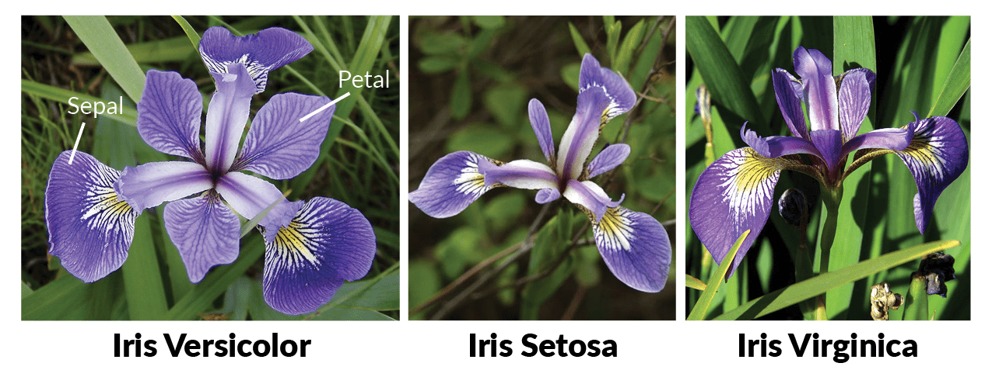
ML Step 1a: eyeball it, though
Let's actually take a look (albeit from the console) at the data just loaded in. This dataset is a collection of measurements of 150 specimens of three different iris subspecies.
# ... previous code goes here
def main():
# ... previous code goes here
df_iris.info()
print(df_iris.head())
if __name__ == '__main__':
main()

Slide 29
ML Step 1b: feature vector | target
the next thing you'll need to do is separate the dataset into a feature vector X and a target y.
# ... previous code goes here
def main():
# ... previous code goes here
X = df_iris.drop(columns='Species')
y = df_iris['Species']
if __name__ == '__main__':
main()

Slide 30
ML Step 1d: Split
The next step is split the data into two sets: a training set and a testing set. Typical split ratio is 75%/25%. The training set will be actually used to create the model. And while it's not required to split the data up in this manner, it's common to do this so that testing set can be used to validate the predictions made by the model. This is done using the previously imported train_test_split.
# ... previous code goes here
def main():
# ... previous code goes here
# training features, testing features, training labels, testing (obscured) labels
X_train, X_test, y_train, y_test = train_test_split(X, y, test_size=0.25, random_state=0,
stratify=y)
if __name__ == '__main__':
main()

Slide 31
ML Step 1d: Split (note!)
Note that:
A test_size of 0.25 means that the algorithm will train with 75% of the dataset.
A random_state of 0 is parallel to using the same seed to create a random number; i.e., "randomizing" the same way every time. This ensures reproducibility of the results.
A stratify of y ensures that the proportion of each label in the target remains the same in both the training and testing targets.
# ... previous code goes here
def main():
# ... previous code goes here
# training features, testing features, training labels, testing (obscured) labels
X_train, X_test, y_train, y_test = train_test_split(X, y, test_size=0.25, random_state=0, stratify=y)
if __name__ == '__main__':
main()
Notes:
Iris.data in the toy dataset is just the X features/input
IRL in your pandas dataframe you will need to specify either a slice indices or a list of column name features that you want to train your model on
Iris.target you will have to specify your label/target/output pandas column

Slide 32
ML Step 1c: Transform?
KNN uses all of the features of a datapoint at the same time in its algorithm. That means that distance itself is susceptible to unbalanced values inside of it. For example: if your dataset had two features of age (in years) and mass (in grams), years wouldn't have much of an effect at all on the result since grams is several orders of magnitude bigger. So you'll need to transform the feature vector such that no feature is more weighted than another. This is done - for this algorithm - via StandardScaler.
Note that because StandardScaler produces an ndarray, you'll need to re-wrap the result into a DataFrame.
# ... previous code goes here
def main():
# ... previous code goes here
scaler = StandardScaler()
scaler.fit(X_train)
# transform and wrap back into DataFrame
X_train = pd.DataFrame(scaler.transform(X_train), columns=X_train.columns, index=X_train.index)
X_test = pd.DataFrame(scaler.transform(X_test), columns=X_test.columns, index=X_test.index)
if __name__ == '__main__':
main()

Slide 33
ML Step 3: train
It's time to train on the dataset and create a model! As stated previously, while there are many algorithmic approaches to ML, for now you're just going to be using KNN.
Note that the code, for now, sets the number of neighbors k (n_neighbors) to 1.
# ... previous code goes here
def main():
# ... previous code goes here
# first create an empty model
model_knn = KNeighborsClassifier(n_neighbors=1)
# then train it
model_knn.fit(X_train, y_train)
if __name__ == '__main__':
main()

Slide 34
ML Step 4: predict (one)
Now that you've got a model, let's test its predictive powers by creating a fake flower and making a prediction on it.
# ... previous code goes here
def main():
# ... previous code goes here
# create a fake flower
X_new = pd.DataFrame([[4.2, 2.6, 1.4, 0.3]],
columns=X_test.columns)
# make a prediction and print it
prediction = model_knn.predict(X_new)
print("prediction:", prediction)
if __name__ == '__main__':
main()

Slide 35
ML Step 4: predict (them all)
You don't need to make fake flowers to test the model, though. You reserved a whole subset of them for this purpose - the testing subset!
Naming convention for this set of predictions is y_pred.
# ... previous code goes here
def main():
# ... previous code goes here
# make all the predictions
y_pred = model_knn.predict(X_test)
if __name__ == '__main__':
main()

Slide 36
scikit-learn: validate
The dataset was split into 75% training and 25% testing groups. To see how accurate the model is, you can use the .score() method and use the testing dataset.
Note: .score() is basically calculating y_pred (from the previous slide) behind the scenes, using X_test; then comparing to y_test known true labels.
# ... previous code goes here
def main():
# ... previous code goes here
print('accuracy:', model_knn.score(X_test, y_test))
if __name__ == '__main__':
main()

Slide 37
Summary of terms
Terminology:
Machine learning
artificial intelligence
Prediction function
Feature
Model
Label
Training and testing
Supervised learning
Unsupervised learning
Reinforcement learning
k-nearest neighbor
Specific vocab/syntax:
StandardScaler()
train_test_split()
KNeighborsClassifier()
.fit()
.predict()
.score()

